Slide 1
Learning to see > Opening our eyes
Lexi He

Slide 2
Part 1: Curating visualizations
01 Passive Exposed

Slide 3
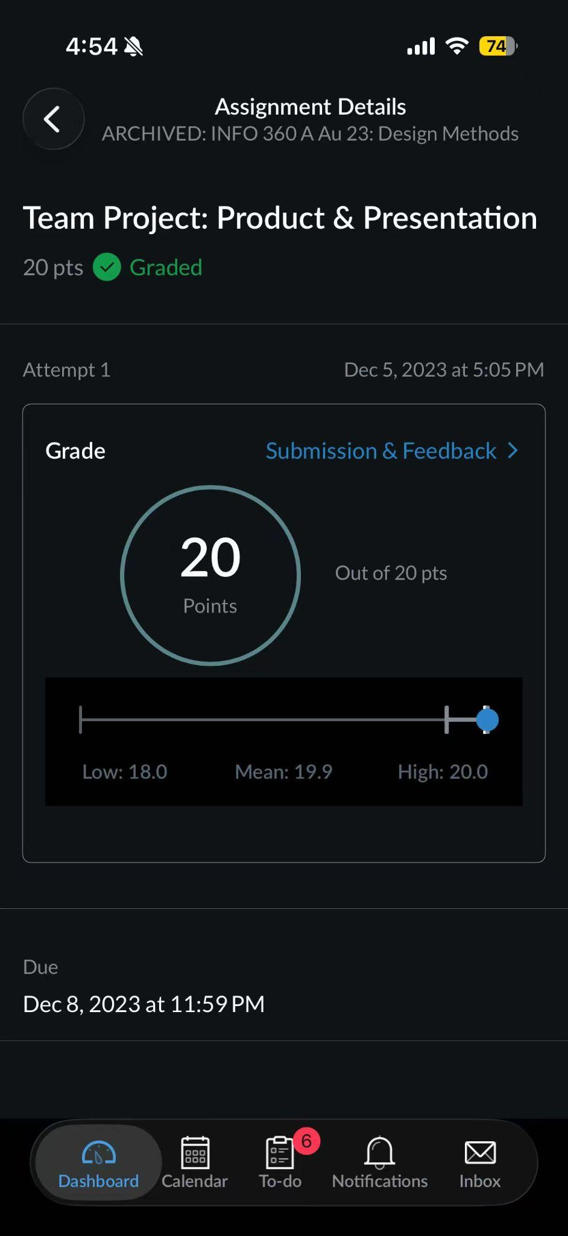
Visualization: Canvas Assignment Grade Overview
How I came across it: I came across this visualization while checking an old assignment result in Canvas. I was not searching for a visualization specifically, but I naturally saw it as part of reviewing my course performance.
Purpose of the visualization: The purpose of this visualization is to show my assignment score clearly and also give some context by showing the class range and average.
My first impression: My first impression was that it looked clear and reassuring. The large score in the center immediately drew my attention and made the result easy to understand.
My impression after 30 seconds: After looking at it for 30 seconds, I noticed that the visualization does more than show a grade. It also tries to position my score within the class distribution. However, the line showing the low, mean, and high values is much smaller and less visually prominent, so that part takes more effort to interpret.

Slide 4
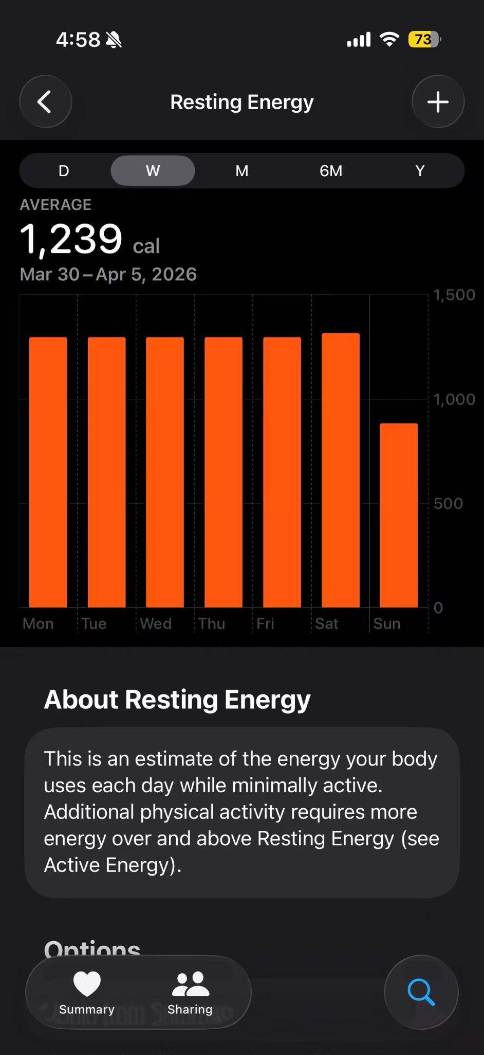
Visualization: Apple Health Resting Energy Chart
How I came across it: I came across this visualization while checking my Health app. It appeared naturally as part of looking at my weekly health data.
Purpose of the visualization: The purpose of this visualization is to show my resting energy over the week and help me understand how that value changes from day to day.
My first impression: My first impression was that the chart looked bold and easy to read. The bars stood out clearly, and the weekly average was easy to notice.
My impression after 30 seconds: After looking at it for 30 seconds, I started paying more attention to the variation across the week, especially the lower value on Sunday. I also noticed that the chart is visually simple, but the meaning of “resting energy” may not be immediately obvious for every user without the explanatory text below it.

Slide 5
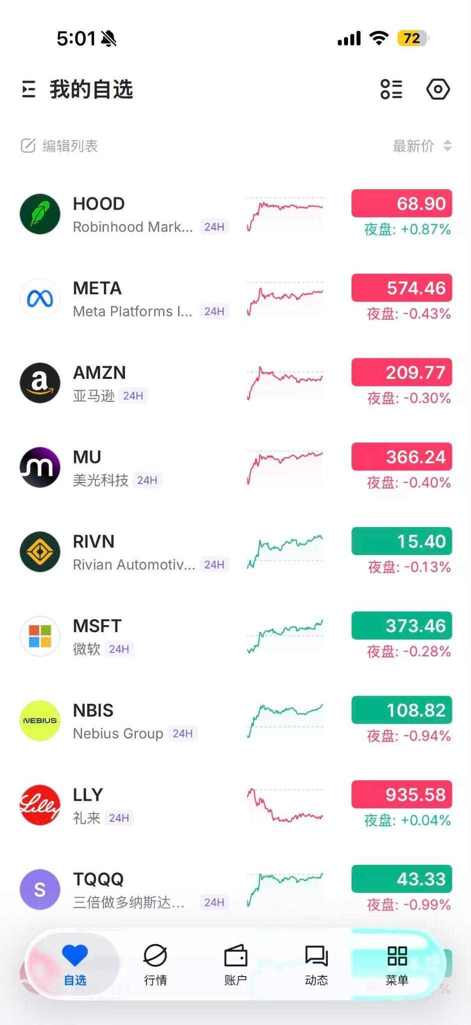
Visualization: Stock Watchlist with Mini Trend Charts
How I came across it: I came across this visualization while looking at a stock watchlist in a finance app. I naturally saw it while checking market movement and my selected stocks.
Purpose of the visualization: The purpose of this visualization is to let users compare multiple stocks quickly by showing their names, current prices, short-term trend lines, and price changes.
My first impression: My first impression was that it looked information-dense but efficient. I could immediately tell that it was designed for quick scanning.
My impression after 30 seconds: After looking at it for 30 seconds, I noticed that the small sparkline charts are useful for showing direction at a glance, but they do not provide much detail. I also noticed that the design relies heavily on red and green, which is common in finance apps but may be less accessible for some users.

Slide 6
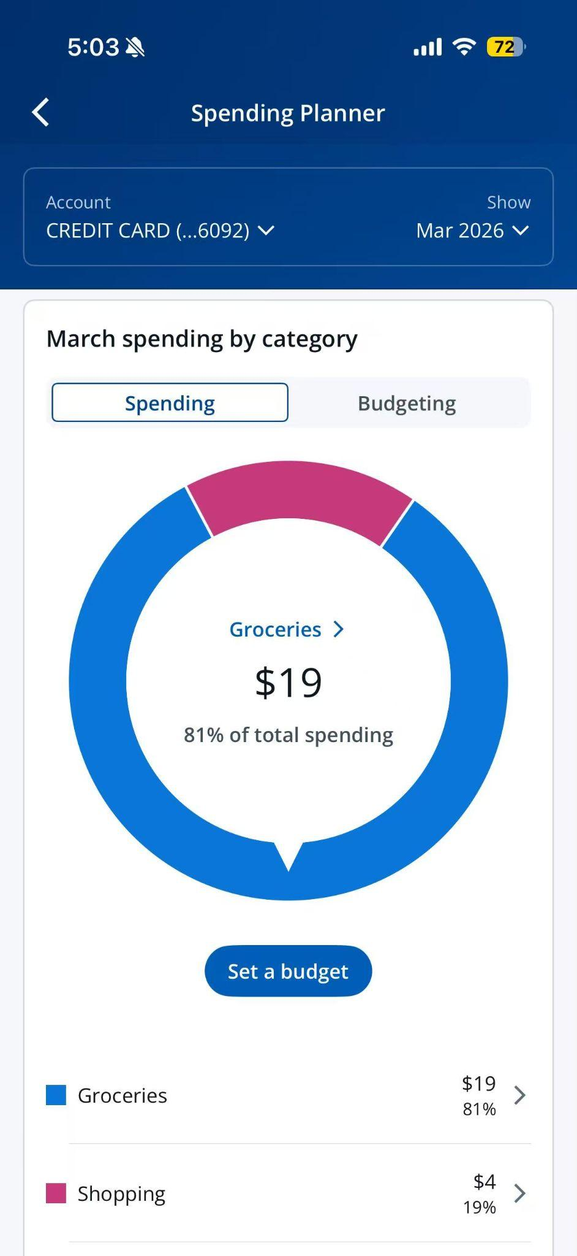
Visualization: Spending Planner Donut Chart
How I came across it: I came across this visualization while checking a spending planner in my banking app. I saw it naturally as part of reviewing my monthly spending.
Purpose of the visualization: The purpose of this visualization is to show how my spending is divided across categories and help me understand which category takes up the largest share.
My first impression: My first impression was that it was clean and visually focused. The large donut chart immediately showed that groceries made up most of the spending.
My impression after 30 seconds: After looking at it for 30 seconds, I noticed that the chart does a good job highlighting the main category by placing the label and percentage in the center. At the same time, I also noticed that donut charts are better for showing broad proportions than precise comparisons, especially if more categories are added.

Slide 7
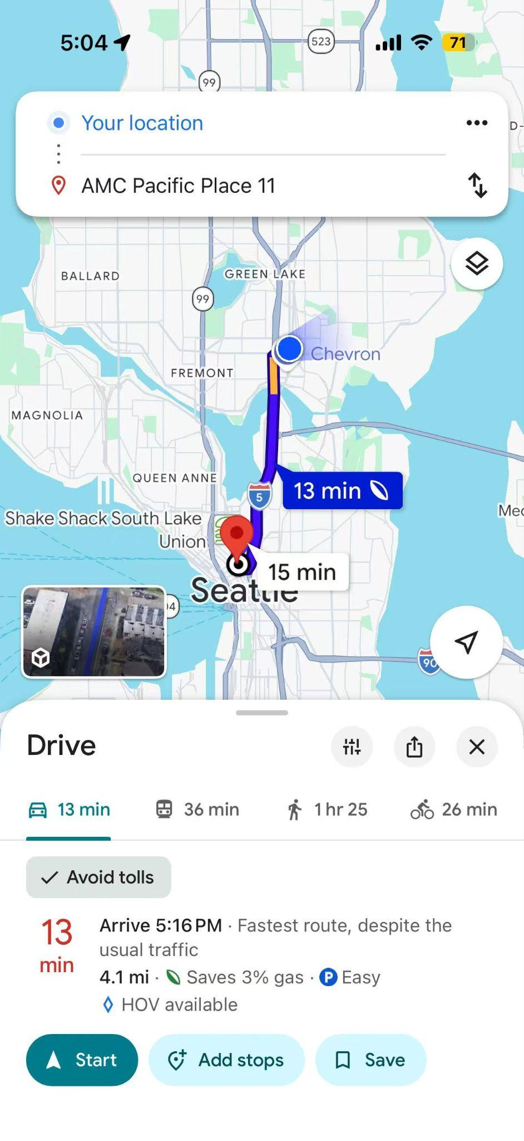
Visualization: Google Maps Route and Traffic View
How I came across it: I came across this visualization while checking directions in Google Maps. I naturally saw it as part of planning a trip across Seattle.
Purpose of the visualization: The purpose of this visualization is to help users compare travel options, understand the suggested route, and estimate travel time based on current traffic conditions.
My first impression: My first impression was that it looked practical and easy to scan. The route, travel time, and mode options were all visible right away.
My impression after 30 seconds: After looking at it for 30 seconds, I noticed how much information is layered into one screen. The route line, estimated time, transportation modes, and traffic context all support decision-making. At the same time, the screen is visually busy, so some details compete for attention, especially on a mobile display.

Slide 8
Part 1: Curating visualizations
02 Actively searching

Slide 9
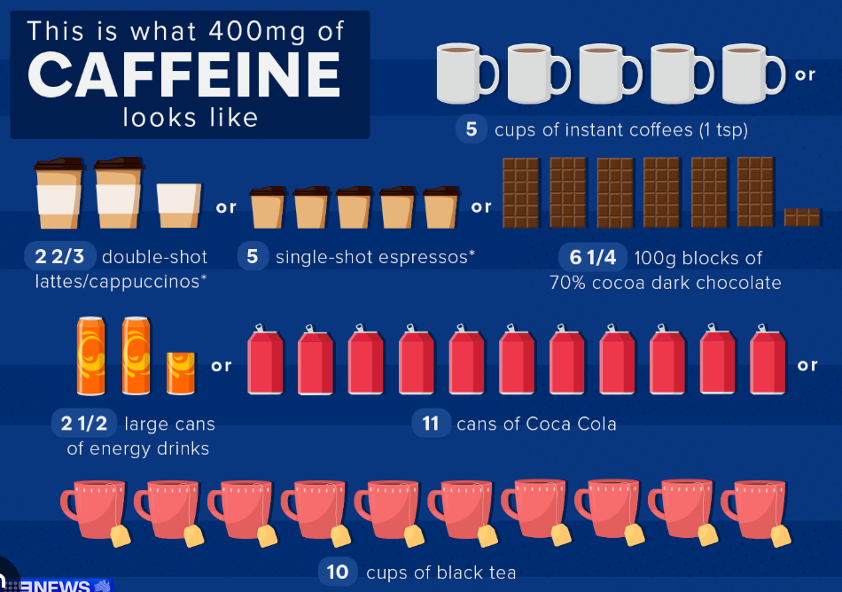
Visualization: Healthy Daily Caffeine Intake
How I came across it: I searched for a visualization about healthy daily caffeine intake because I wanted to know how much caffeine a person can consume each day without going over a healthy limit.
Purpose of the visualization: The purpose of this visualization is to show the recommended daily caffeine limit in a quick and easy-to-understand way.
My first impression: My first impression was that the visualization was clear and practical. It immediately felt useful because it answered a common everyday health question.
My impression after 30 seconds: After looking at it for 30 seconds, I noticed whether the information was simplified or detailed. I could better see if the design helped me compare amounts easily, or if it relied too much on icons and text instead of making the numbers visually clear.

Slide 10
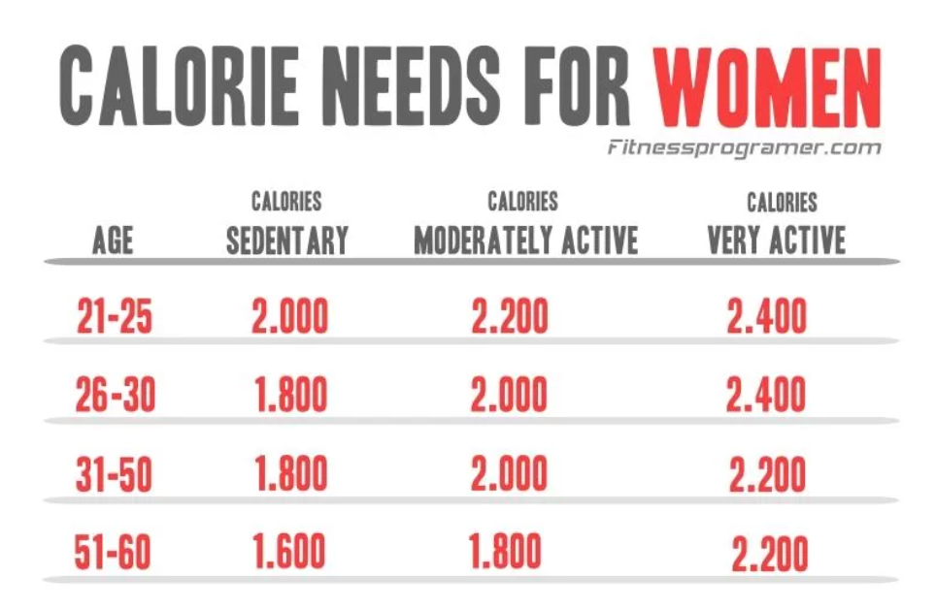
Visualization: Recommended Daily Calorie Intake for Women
How I came across it: I searched for a visualization about the recommended daily calorie intake for women because I wanted to see how calorie needs are explained in a visual format.
Purpose of the visualization: The purpose of this visualization is to communicate general calorie intake recommendations and help viewers quickly understand daily energy needs.
My first impression: My first impression was how could I calculate how much I consume each day.
My impression after 30 seconds: After 30 seconds, I started paying more attention to whether the chart showed enough context, such as age, activity level, or body differences. I also noticed whether the design made the numbers easy to compare or whether it oversimplified a more complex issue.

Slide 11
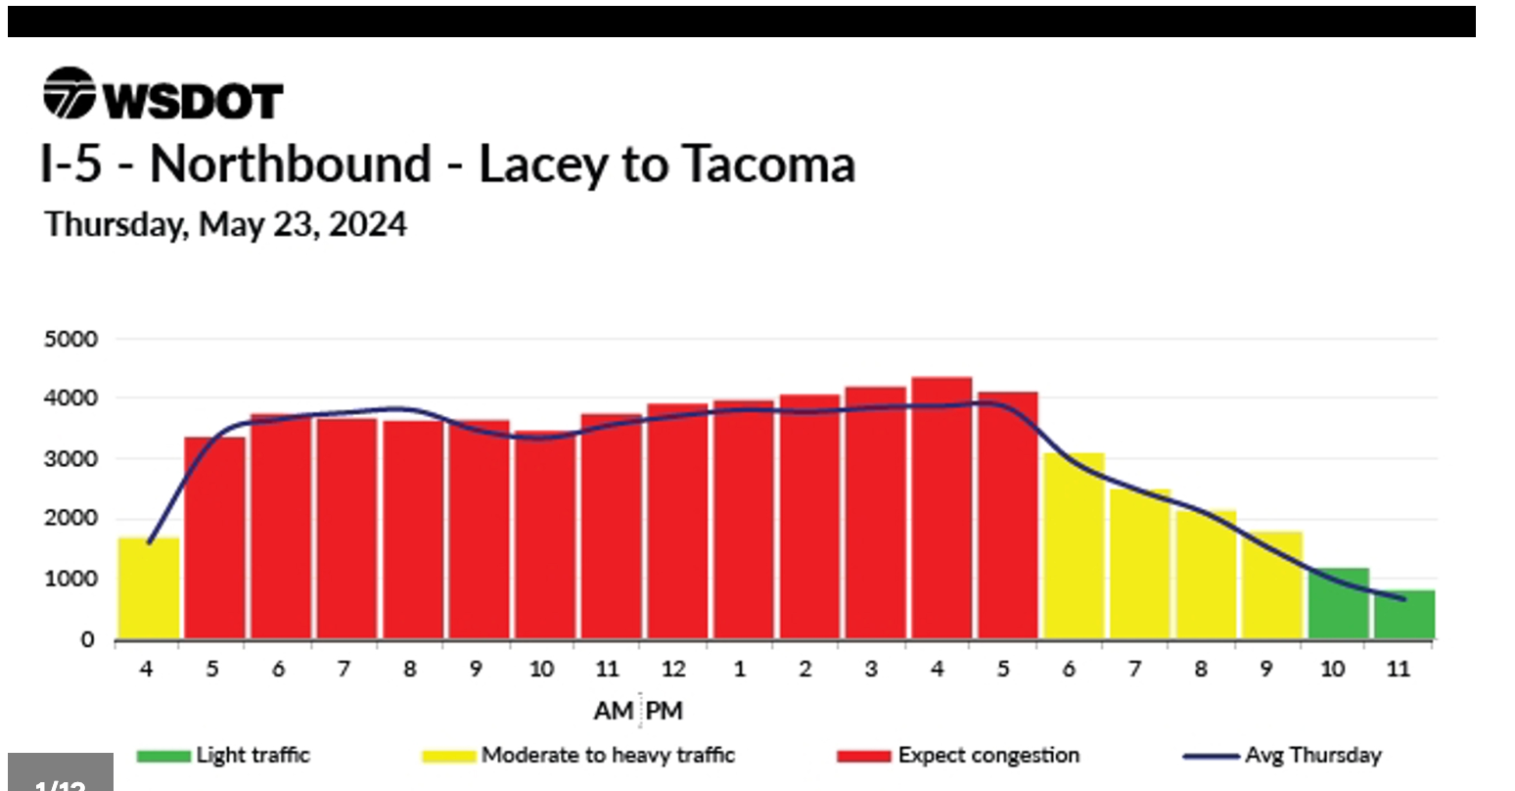
Visualization: Seattle Traffic Congestion Trend Today
How I came across it: I searched for a visualization about Seattle traffic congestion today because I wanted to see how traffic conditions were presented visually across time or location.
Purpose of the visualization: The purpose of this visualization is to help users quickly understand traffic patterns and make travel decisions more easily.
My first impression: My first impression was that the visualization was functional and easy to scan, especially if it used color to show different levels of congestion.
My impression after 30 seconds: After looking at it for 30 seconds, I paid more attention to how clearly the colors, labels, and map or chart layout communicated the actual traffic situation. I also started to notice whether the design would still work well for users who are not familiar with the city or for users with color vision limitations.

Slide 12
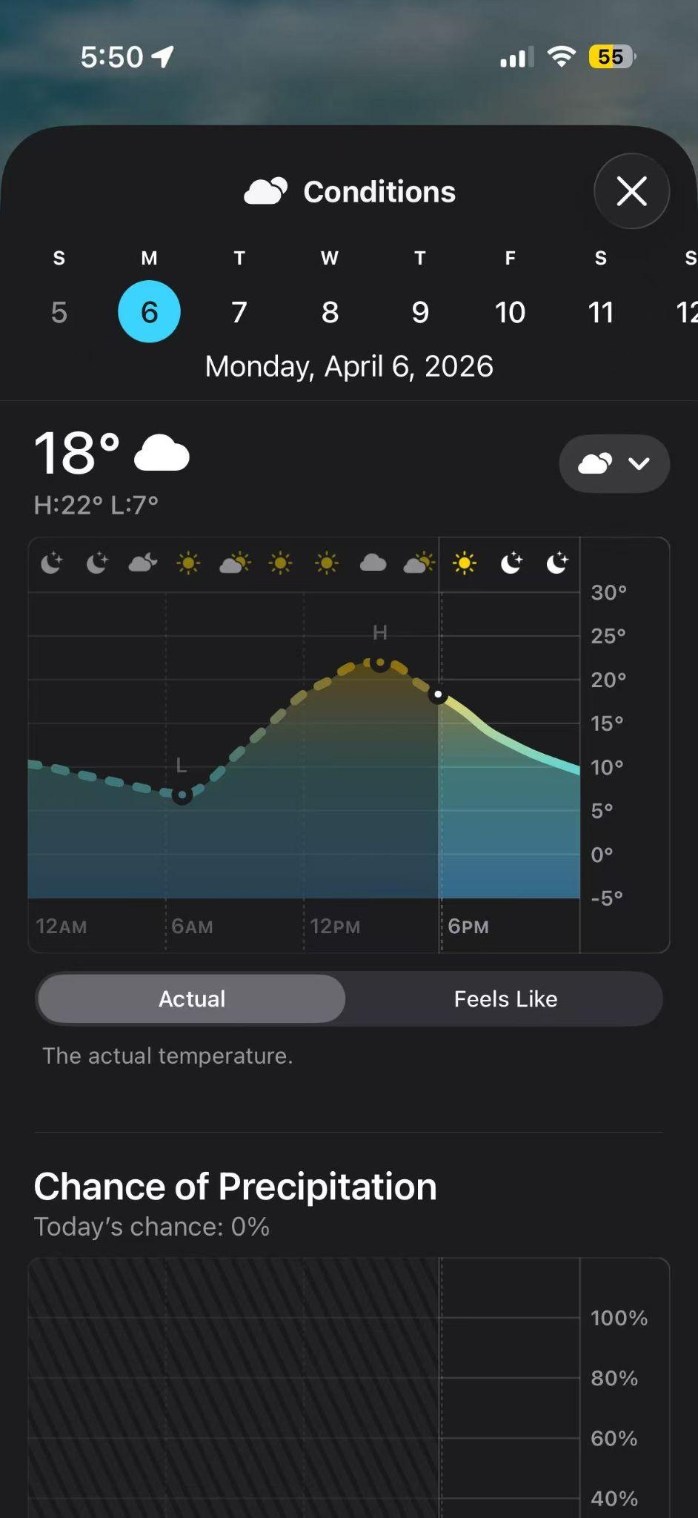
Visualization: Temperature Trend for Today
How I came across it: I searched for a visualization showing today’s temperature trend because I wanted to know how the temperature changes throughout the day.
Purpose of the visualization: The purpose of this visualization is to present hourly or daily temperature changes in a way that is quick and easy to understand.
My first impression: My first impression was that the visualization looked simple and effective. I could immediately get a sense of whether the day would get warmer or cooler.
My impression after 30 seconds: After 30 seconds, I noticed more details in the structure of the chart, such as whether the time labels were clear, whether the temperature pattern was easy to follow, and whether the design highlighted the most important change points in the day.

Slide 13
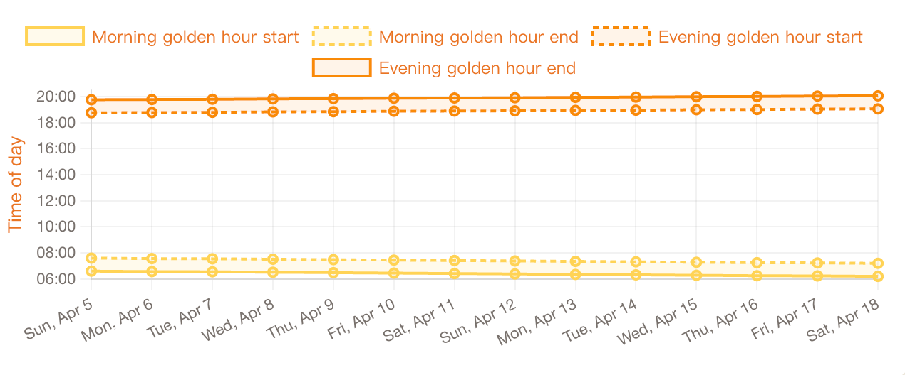
Visualization: Golden Hour for Photography Today
How I came across it: I searched for a visualization about today’s golden hour for photography because I wanted to know the best time of day for taking photos in natural light.
Purpose of the visualization: The purpose of this visualization is to show when golden hour happens and help photographers make practical decisions about timing.
My first impression: My first impression was that the visualization felt very relevant and personally useful because it connects visual information to a real creative activity.
My impression after 30 seconds: After looking at it for 30 seconds, I started to think more carefully about how clearly it showed the timing, how easy it was to interpret, and whether it gave enough context, such as sunrise, sunset, or the length of the golden hour window.

Slide 14
Part 2: Critiquing

Slide 15
Observation 1
This visualization is trying to answer a simple question: where did most of my spending go this month? It works well because the largest category is immediately visible. The center label also helps connect the category name, dollar amount, and percentage in one place, so the main message is easy to understand at a glance.
Observation 2
At the same time, the chart is more effective for showing broad proportions than precise comparison. A donut chart is visually strong when one category clearly dominates, but it becomes less effective when users need to compare categories accurately or when more categories are added. A ranked bar chart could make detailed comparison easier.
Donut chart works for broad proportions, not precise comparison
Would become harder to read with more categories
Center label connects category, value, and percentage
Strong visual focus on the largest category

Slide 16
Observation 1
This visualization is designed for users who want to scan many stocks quickly. It communicates short-term movement through price, color, and mini trend lines, and it works well for fast comparison in a compact space. The intended audience seems to be users who already have some familiarity with financial apps and market tracking.
Observation 2
However, the visualization is less accessible and less informative than it first appears. The small sparkline charts show general direction, but without a visible axis or scale, they can be easy to overinterpret. The strong reliance on red and green also creates an accessibility issue for some users with color vision limitations. A more accessible version could use symbols, clearer labels, or optional expanded charts for comparison.
Designed for fast scanning
No visible axis or scale
Mini trend lines show direction quickly
Red and green rely heavily on color coding
May be difficult for colorblind users
Notes:
Observation 1
This visualization is designed for users who want to scan many stocks quickly. It communicates short-term movement through price, color, and mini trend lines, and it works well for fast comparison in a compact space. The intended audience seems to be users who already have some familiarity with financial apps and market tracking.
Observation 2
However, the visualization is less accessible and less informative than it first appears. The small sparkline charts show general direction, but without a visible axis or scale, they can be easy to overinterpret. The strong reliance on red and green also creates an accessibility issue for some users with color vision limitations. A more accessible version could use symbols, clearer labels, or optional expanded charts for comparison.

Slide 17
Observation 1
This visualization is trying to answer a very practical question: which route should I take right now? It works well because the route, estimated travel time, and travel modes are all visible quickly. The map uses color, icons, and layout effectively to support immediate decision-making.
Observation 2
At the same time, the screen is visually crowded. The route line, travel time, transportation options, map labels, buttons, and descriptive text all compete for attention on a small mobile display. This design is useful, but it depends heavily on visual hierarchy to stay readable. A cleaner version might hide secondary details until the user taps for more information.
Color and icons support fast decision-making
Route and ETA are the first things users notice
Many layers compete for attention
Multiple travel modes add useful context
Notes:
Observation 1
This visualization is trying to answer a very practical question: which route should I take right now? It works well because the route, estimated travel time, and travel modes are all visible quickly. The map uses color, icons, and layout effectively to support immediate decision-making.
Observation 2
At the same time, the screen is visually crowded. The route line, travel time, transportation options, map labels, buttons, and descriptive text all compete for attention on a small mobile display. This design is useful, but it depends heavily on visual hierarchy to stay readable. A cleaner version might hide secondary details until the user taps for more information.

Slide 18
Part 3: Sketching & Iterating

Slide 19
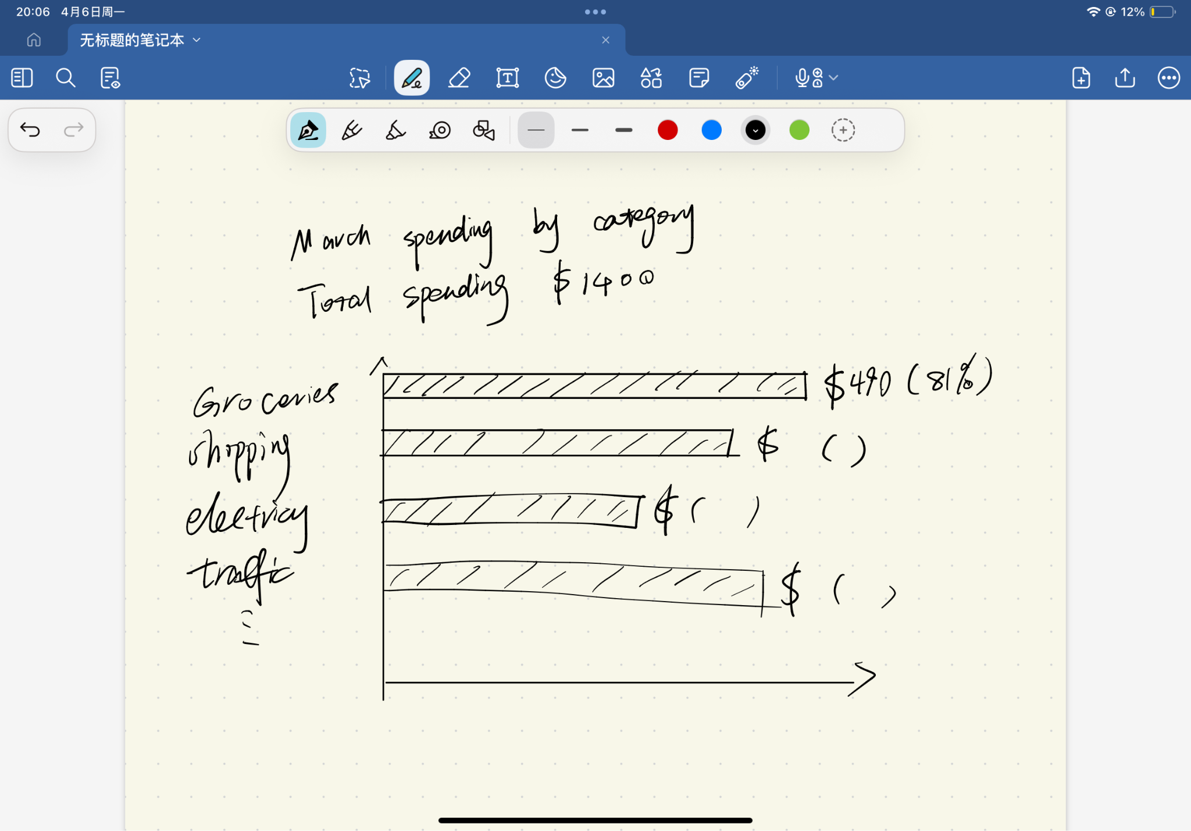
Annotated Sketch
Audience: Everyday banking app users who want a fast summary of where their money went.
Question answered: Which spending category took the largest share this month?
What works better now: The largest category stands out immediately, and the comparison is more precise.
Accessibility: The design uses labels and values, not color alone.
Why this is stronger: It reduces visual clutter and supports clearer comparison.
Answers the question quickly
Bars make comparison easier
Works better if more categories are added
More scalable

Slide 20
Why My Redesign Is Better
For the redesigning, I change the donut chart to a horizontal bar chart. The original image is visually simple and easy to browse, but it is better at showing the overall proportion rather than precise comparison. I hope the new version can answer the core questions more clearly. For instance, where did most of the expenses this month go? By using bar charts, I made the differences between various categories easier to compare. It also makes the core information more intuitive.
I think this version works better because it is more concise, clean and more practical. Users can quickly see which category costs the largest proportion. And the exact figures are directly displayed rather than inferred through circular Outlines. Furthermore, as the new design not only relies on color but also provides more accurate information. Even if more categories are added, this format will still remain clear and easy to read. Overall, the new design is better than the original one.

